Slide 1
Olist Target Market Performance 2016 - 2018

Slide 2
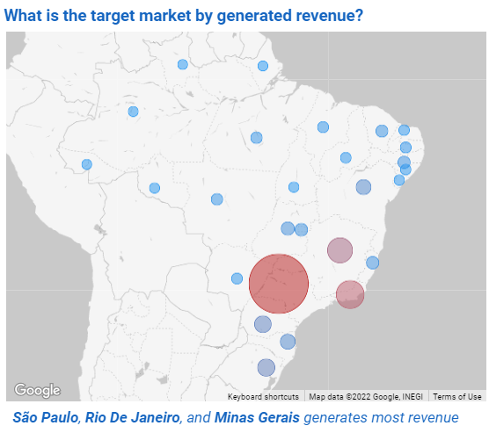

Olist Target Market
São Paulo, Rio de Janeiro, Minas Gerais dominate
Together these states generate 63% of revenue from customers’ side

Slide 3
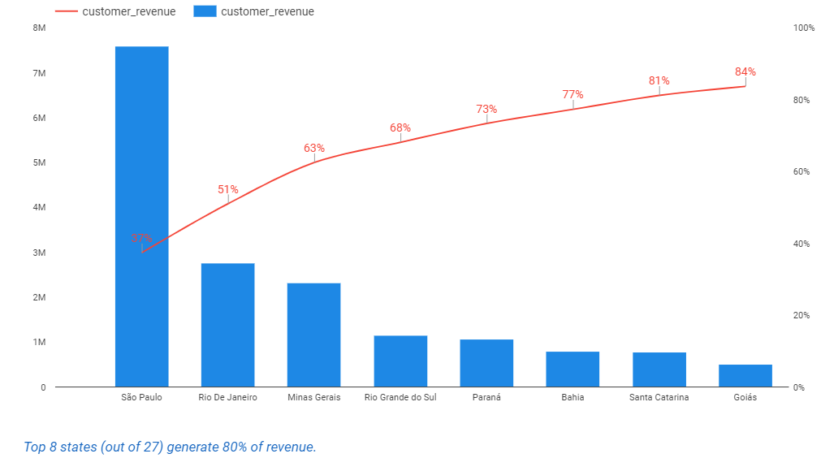

Revenue distribution by states
Not equal distribution in states
Pareto principle applies to revenue generation.

Slide 4
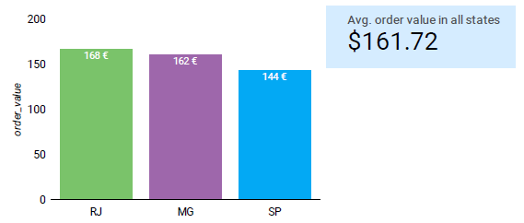

Basket size ($) in top 3 states
Regular basket
Source of high revenue for top 3 states is number of orders, not high basket size.

Slide 5
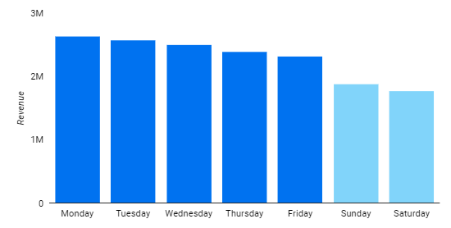
Week performance in top 3 states
Workdays
Most revenue is generated during working days

Slide 6
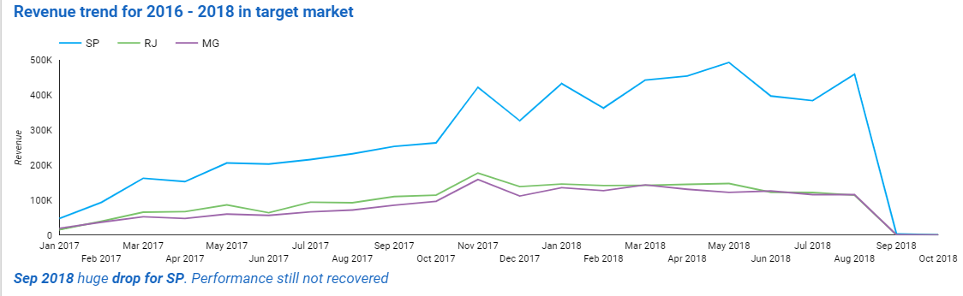

Revenue & delivery trend in top 3 states

Slide 7
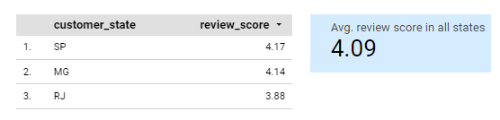
Review scores in top 3 states
Rio De Janeiro
This state identifies an issue in product/delivery/service performance.

Slide 8
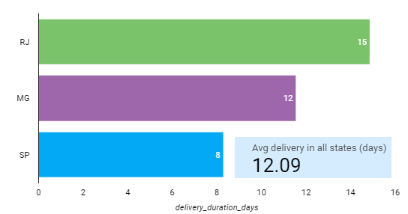
Delivery duration in top 3 states
Rio De Janeiro – long delivery
Could be the source of low review scores

Slide 9
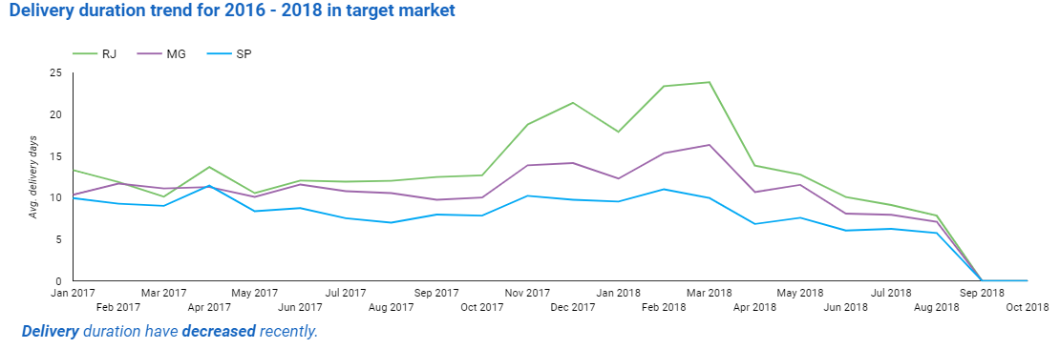
Revenue & delivery trend in top 3 states

Slide 10
Conclusions & Recommendations 1
Conclusion
Recommendations
01
São Paulo, Rio de Janeiro, Minas Gerais is target market by Pareto principle
Diversify growth strategy for these states.
Other states are significantly underperforming compared to target market
02
Develop to other states more intensively in order to eliminate risk due to lack of diversification.
03
Rio de Janeiro review scores requires improvement
Scores could be improved by through shipping duration reduction.

Slide 11
Conclusions & Recommendations 2
Conclusion
Recommendations
04
Significant revenue drop in September 2018. Review scores also dropped during this month
Investigate service/product offered by sellers quality.
05
Most revenue is generated during workdays
More advertising during working days

